Slide 1
ETRSS-1 TT&C Interface Between Spacecraft and GCS
DFH SATELLITE CO.,LTD
February.2019

Slide 2
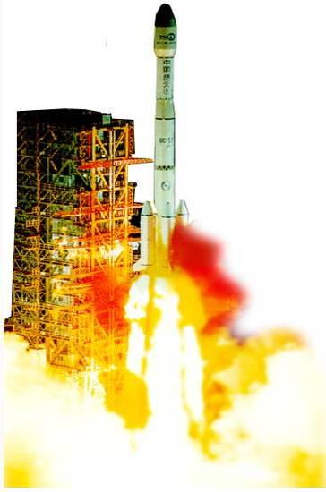


Outlines
1 Introduction
2 Task Requirement
3 Satellite TT&C Subsystem
4 Interface with the Ground TT&C
5 Rule of Sending TC and Data Block
PAGE 2

Slide 3
1 Introduction
Familiar with the TT&C subsystem composition.
Familiar with the TT&C interface between satellite and GCS.
Familiar with the rules of Injecting Data Block.

Slide 4
Outlines
1 Introduction
2 Task Requirement
3 Satellite TT&C subsystem
4 Interface with the Ground TT&C
5 Rule of Sending TC and Data Block
PAGE 4

Slide 5
2 Task Requirement
Requirements to GCS
Provide the orbit parameter and predict the orbit information for satellite
Receive TM , send TC and data block
Time calibration and Time transfer
Monitor and manage the satellite
Emergency rescue in fault mode

Slide 6
2 Task Requirement
Requirements to TT&C Subsystem of sattellite
Receive and demodulate S-band up-link signal from GCS
Transmit S-band downlink telemetry signal
Provide quasi-omniderictional antennas
To acquire and track the GPS navigation signal , provide satellite’s position, velocity and time

Slide 7
Outlines
1 Introduction
2 Task Requirement
3 Satellite TT&C subsystem
4 Interface with the Ground TT&C
5 Rule of Sending TC and Data Block
PAGE 7

Slide 8
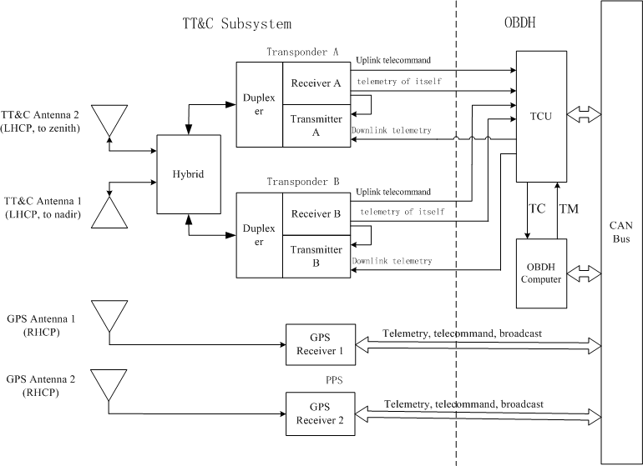
3 Satellite TT&C subsystem

Slide 9
3 Satellite TT&C subsystem
Status of transponder
The two receivers of transponders are both on
Only one of the two transmitters is on(A on or B on)
operation modes
Mode 1:TM only for downlink
Mode2 :TC for uplink and TM for downlink

Slide 10
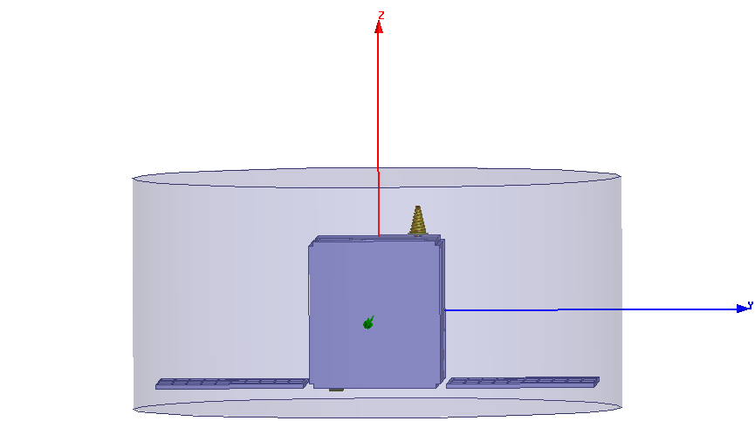
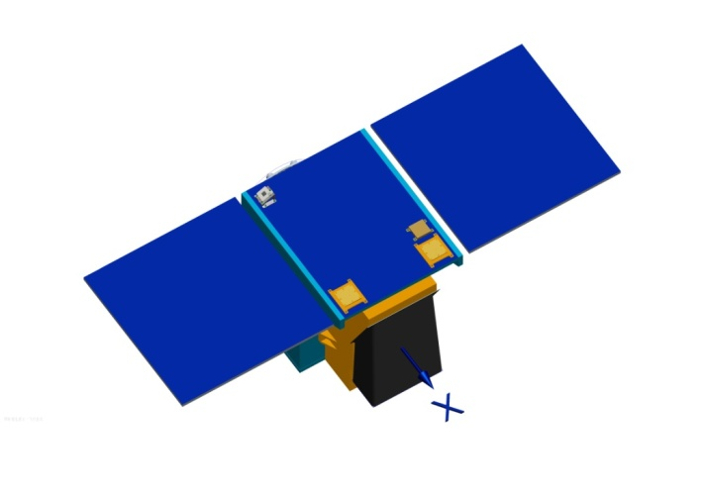
3 Satellite TT&C subsystem
Status of TT&C Antenna
To nadir
Conical spiral atanna
LHCP
To zenith
Microstrip atanna
LHCP

Slide 11
3 Satellite TT&C subsystem
Status of GPS Receiver
Only one of the two receivers is on(A on or B on)
Real-time mode
GPS receiver works in position lock status
Provide real time high precision position data and PPS
Extrapolating
GPS receiver works in positioning unlock status.
Provide extrapolating position data. No PPS.

Slide 12
3 Satellite TT&C subsystem
Time system
Satellite-rocket separation Time
(T0) zero as the start time ,used for initial orbit phase.
UTC time
Jan 1, 2009 used as the start time (GMT 00:00:00)
THIS DOCUMENT CONTAINS PROPRIETARY INFORMATION OF CHINA ACADEMY OF SPACE TECHNOLOGY, AND MAY NOT BE REPRODUCED, COPIED, DISCLOSED, UTILIZED, PLACED OR TRANSMITTED ON INTERNET, IN WHOLE OR IN PART, WITHOUT PRIOR WRITTEN AUTHORIZATION.
PAGE 12

Slide 13
3 Satellite TT&C subsystem
Satellite time calibration
GPS time calibration
Allowed by default when GPS receiver is in positioning status
Ground station calibration
Calibrated by injecting data from ground station
THIS DOCUMENT CONTAINS PROPRIETARY INFORMATION OF CHINA ACADEMY OF SPACE TECHNOLOGY, AND MAY NOT BE REPRODUCED, COPIED, DISCLOSED, UTILIZED, PLACED OR TRANSMITTED ON INTERNET, IN WHOLE OR IN PART, WITHOUT PRIOR WRITTEN AUTHORIZATION.
PAGE 13

Slide 14
3 Satellite TT&C subsystem
GPS time calibration
GPS time transfer
Use GPS time as satellite time (used for large deviation)
GPS time calibration
Satellite time is calibrated step by step until reach the GPS time.
THIS DOCUMENT CONTAINS PROPRIETARY INFORMATION OF CHINA ACADEMY OF SPACE TECHNOLOGY, AND MAY NOT BE REPRODUCED, COPIED, DISCLOSED, UTILIZED, PLACED OR TRANSMITTED ON INTERNET, IN WHOLE OR IN PART, WITHOUT PRIOR WRITTEN AUTHORIZATION.
PAGE 14

Slide 15
3 Satellite TT&C subsystem
Ground station time calibration
Mean time calibration
Calibrating time periodically by the tele-command(Δt+ interval time)
Centralized time calibration
Calibrating time at a time by the tele-command (Δt)
Transfer time
Calibrating time at a time by the tele-command(absolute time)
THIS DOCUMENT CONTAINS PROPRIETARY INFORMATION OF CHINA ACADEMY OF SPACE TECHNOLOGY, AND MAY NOT BE REPRODUCED, COPIED, DISCLOSED, UTILIZED, PLACED OR TRANSMITTED ON INTERNET, IN WHOLE OR IN PART, WITHOUT PRIOR WRITTEN AUTHORIZATION.
PAGE 15

Slide 16
Outlines
1 Introduction
2 Task Requirement
3 Satellite TT&C subsystem
4 Interface with the Ground TT&C
5 Rule of Sending TC and Data Block
PAGE 16

Slide 17
4 Interface with the Ground TT&C
RF Channel
Item | Index
Carrier frequency | to be continued (上行) to be continued (下行)
EIRP of ground station | ≥47.95dBW
EIRP of satellite | ≥ -13.01dBW
G/T of ground station | ≥13.45 dB/K
G/T of satellite | ≥-38.33 dB/K
Acquisition sensitivity of satellite | ≥-106 dBm（32 kHz/s）
Antenna polarization | LHCP
THIS DOCUMENT CONTAINS PROPRIETARY INFORMATION OF CHINA ACADEMY OF SPACE TECHNOLOGY, AND MAY NOT BE REPRODUCED, COPIED, DISCLOSED, UTILIZED, PLACED OR TRANSMITTED ON INTERNET, IN WHOLE OR IN PART, WITHOUT PRIOR WRITTEN AUTHORIZATION.
PAGE 17

Slide 18
4 Interface with the Ground TT&C
Item | Tele-Command | Telemetry
Modulation | PCM/BPSK/PM | PCM/BPSK/PM
Sub-carrier frequency | 8 kHz | 65.536 kHz
Bit rate | 2000 bps | 4096 bps
modulation index | 0.7 rad ±5% | 1.15 rad ±10%
PCM code type | NRZ-L | NRZ-S
Bit error rate | ≤ 1×10⁻⁶ | ≤ 1×10⁻⁶
THIS DOCUMENT CONTAINS PROPRIETARY INFORMATION OF CHINA ACADEMY OF SPACE TECHNOLOGY, AND MAY NOT BE REPRODUCED, COPIED, DISCLOSED, UTILIZED, PLACED OR TRANSMITTED ON INTERNET, IN WHOLE OR IN PART, WITHOUT PRIOR WRITTEN AUTHORIZATION.
PAGE 18

Slide 19
Outlines
1 Introduction
2 Task Requirement
3 Satellite TT&C subsystem
4 Interface with the Ground TT&C
5 Rule of Sending TC and Data Block
PAGE 19

Slide 20
5 Rule of Sending TC and Data Block
Tele-command frame
Direct command frame
Indirect Data block frame
THIS DOCUMENT CONTAINS PROPRIETARY INFORMATION OF CHINA ACADEMY OF SPACE TECHNOLOGY, AND MAY NOT BE REPRODUCED, COPIED, DISCLOSED, UTILIZED, PLACED OR TRANSMITTED ON INTERNET, IN WHOLE OR IN PART, WITHOUT PRIOR WRITTEN AUTHORIZATION.
PAGE 20

Slide 21
5 Rule of Sending TC and Data Block
Satellite Mode Word
Tele-command Format | Mode Word
Direct command frame72bits | CCH
Data block frame, the data area length is 128 bits | 5AH
Data block frame, the data area length is 512 bits | 69H
Data block frame, the data area length is 1024 bits | 99H
Data block frame, the data area length is 2048 bits | A5H
THIS DOCUMENT CONTAINS PROPRIETARY INFORMATION OF CHINA ACADEMY OF SPACE TECHNOLOGY, AND MAY NOT BE REPRODUCED, COPIED, DISCLOSED, UTILIZED, PLACED OR TRANSMITTED ON INTERNET, IN WHOLE OR IN PART, WITHOUT PRIOR WRITTEN AUTHORIZATION.
PAGE 21

Slide 22
5 Rule of Sending TC and Data Block
Telemetry Frame (128Byte, Fixed lengh)
0 | 1 | 2 | 3 | 4 | 5 | 6 | 7 | 8 | … | … | 13 | 14 | 15 | 16 | 17 | … | 127
EB | 90 | ## | ## | ## | ## | ## | ## | ## | … | … | ## | ## | ## | ## | ## | … | ##
Frame Synchronization Marker |  | Encryption information |  |  |  | Identity code |  | Fixed Format Telemetry |  |  |  | Master Channel Frame count | Virtual Channel Frame count | Master Header Pointer | Data Field
2bytes |  | 4bytes |  |  |  | 2bytes |  | 6bytes |  |  |  | 1bytes | 1bytes | 1bytes | 111bytes

Slide 23
5 Rule of Sending TC and Data Block
Interval time
Direct command
Data block frame
THIS DOCUMENT CONTAINS PROPRIETARY INFORMATION OF CHINA ACADEMY OF SPACE TECHNOLOGY, AND MAY NOT BE REPRODUCED, COPIED, DISCLOSED, UTILIZED, PLACED OR TRANSMITTED ON INTERNET, IN WHOLE OR IN PART, WITHOUT PRIOR WRITTEN AUTHORIZATION.
PAGE 23

Slide 24
Thank you

